Slide 1
Configuring Router
Dr. Risala T Khan
Professor
IIT, JU

Slide 2
Objective
Configuring Privilege Mode and Global Parameters
configure terminal
hostname name
enable secret password
no ip domain-lookup
Configure Fast Ethernet LAN Interfaces

Slide 3

Router Mode
There are four modes to configure and access Cisco Router:
user EXEC mode,
privileged EXEC mode,
global configuration mode,
interface configuration mode
user EXEC mode is the initial startup mode. A router configuration session can be initiated using terminal emulation programs such as Kermit, HyperTerminal, or telnet.
privileged EXEC mode is the system administrator mode. In this mode configuration files can be read, the router can be rebooted, and operating parameters can be changed.
global configuration mode is used to modify system-wide configuration parameters, such as routing tables and routing algorithms.
interface configuration mode is used to modify the Ethernet and serial port configurations.

Slide 4

How to change modes
user Exec mode is entered by starting a terminal emulation program, such as kermit or HyperTerminal, or by starting a telnet session. The workstation must physically be connected to the console port on the router by either a rollover cable (kermit or HyperTerminal) or to an Ethernet port by a standard patch cable (telnet).
The user Exec mode prompt has the following form: RouterName>
privileged Exec mode is entered from user Exec mode by typing enable. A password must be supplied to complete the connection.
The privileged Exec mode prompt has the following form: RouterName#
global configuration mode is entered from privileged Exec mode by typing configure terminal or config t. No password is required.
The global configuration mode prompt has the following form: RouterName (config)#
interface configuration mode is entered from global configuration mode by typing interface InterfaceName, where the InterfaceName is either Ethernet0, Serial0, or Serial1.
The interface configuration mode prompt has the following form: RouterName(config-if)#

Slide 5

Exiting Mode
To exit interface configuration mode type exit. This will return the system to global configuration mode.
To exit global configuration mode type exit. This will return the system to privileged Exec mode.
To exit global configuration mode type disable. This will return the system to user Exec mode.
To exit user Exec mode type logout. This will end the session.

Slide 6

How to get Command Help
Typing ? will display a list of commands for that mode.
Typing part of a command followed by a ? will display additional information about that command.

Slide 7

Selected Privileged Exec Mode Commands
show running-config – displays current router configuration for the router
show startup-config – displays the startup configuration for the router
reload – restarts the router. Discards running configuration and reloads startup configuration
copy running-config startup-config – saves the current configuration to NVRAM. The new configuration takes effect after the router is rebooted.
show ip route – displays the contents of the routing table
clear ip route – deletes all routing table entries
show interfaces – displays information about all network interfaces

Slide 8
Selected Global Configuration Commands
ip routing – enables IP forwarding
no ip routing – disables IP forwarding and deletes content of routing table
ip route-cache – enables route caching (default mode)
no ip route-cache – disables route caching
ip route [ipDestinationAddr subnetmask gw_address ]– adds a static route to the routing table. gw_address is the IP address of the default gateway (next hop router)
ip route 10.21.0.0 255.255.0.0 10.11.1.4 – this command adds a route to the routing table for network 10.21.0.0 with subnet mask 255.255.0.0. 10.11.1.4 is the default gateway (next hop router) address.
ip route 0.0.0.0 0.0.0.0 10.0.4.4 – this command adds 10.0.4.4 as a default gateway
ip route [ipDestinationAddr subnetmask Interface] – similar to above, but Interface is the network interface name
no ip route [ipDestinationAddr subnetmask gw_address] – deletes route table entry
no ip route [ipDestinationAddr subnetmask Interface] – deletes route table entry

Slide 9
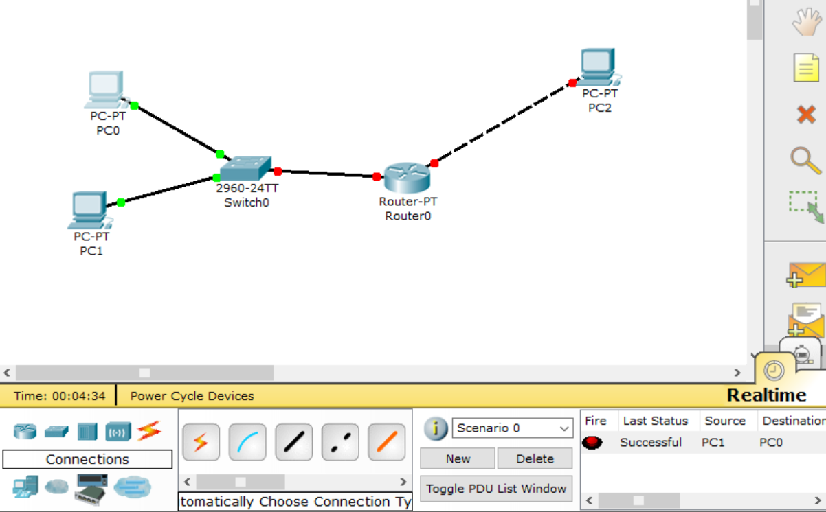
Topology
PC0: 192.168.1.2
PC1: 192.168.1.0
Fastethernet 0/0: 192.168.1.3
Fastethernet 1/0: 192.166.2.1
PC2: 192.168.2.2

Slide 10
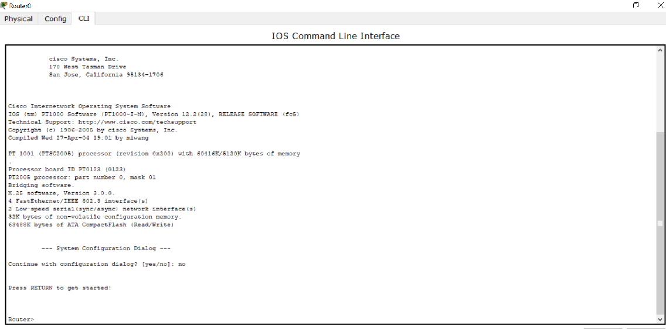
Configuring the Router
Click on the “router” and go to “CLI” bar
Choose “no” and enter
When you will find “Router>” prompt write “enable” and press enter
Then write “configure terminal” or “conf t” and press enter

Slide 11
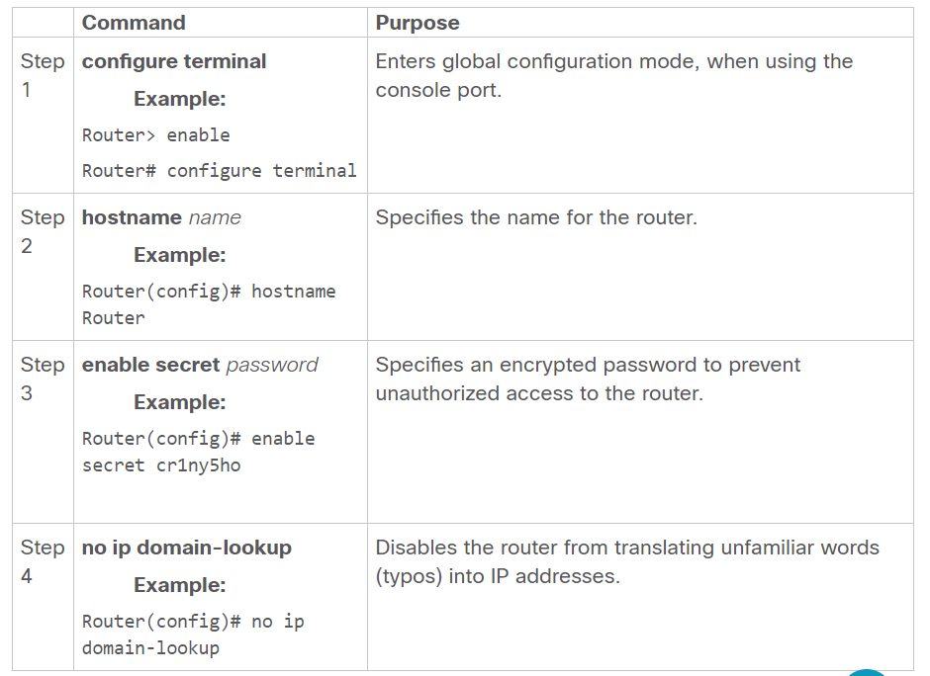
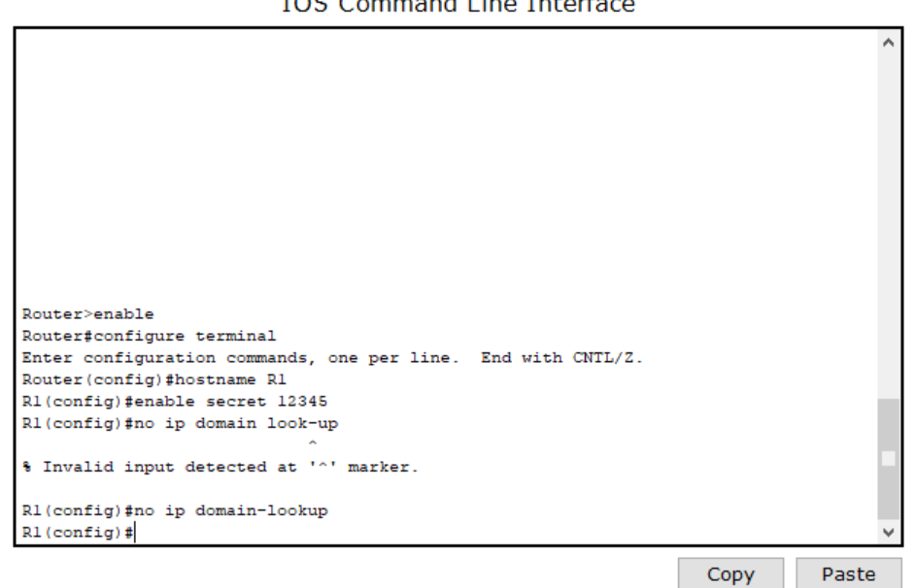
Configuring Global Parameters

Slide 12
Configuring Fast Ethernet LAN Interfaces
Command | Purpose
S1:interface fastethernet slot/port Example: R1(config)# interface fastethernet 0/1 | Enters the configuration mode for a fast Ethernet interface on the router.
S2: ip address ip-address mask Example: R1(config-if)# ip address 192.168.1.3 255.255.255.0 | Sets the IP address and subnet mask for the specified FE interface.
S3: no shutdown Example: R1(config-if)# no shutdown | Enables the FE interface, changing its state from administratively down to administratively up.
R1(config)#interface fastethernet 0/0
R1(config-if)#ip address 192.168.1.3 255.255.255.0
R1(config-if)#no shutdown
%LINK-5-CHANGED: Interface FastEthernet0/0, changed state to up
%LINEPROTO-5-UPDOWN: Line protocol on Interface FastEthernet0/0, changed state to up
R1(config-if)#
R1#

Slide 13
Class Work
Configure Router fastethernet interface 1/0 in similar way with ip address 192.168.2.1
Configure PC2 with ip address 192.168.2.2
Ping PC2 from PC0

